Slide 1

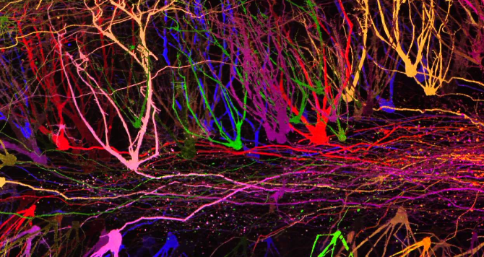
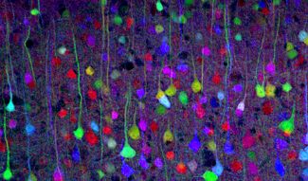
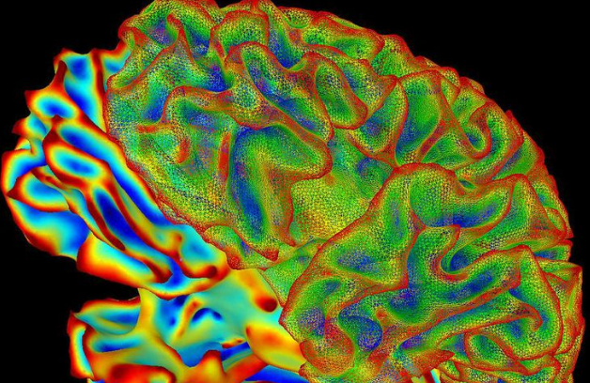
Preparing for the Post-baccalaureate Year
Natalie Paredes
Christian Cazares
Thursday January 25th, 2024

Slide 2
Today’s Outline
01
02
03
Introductions
Gap year options
Benefits of the gap year
04
05
Q & A
Writing your
application

Slide 3
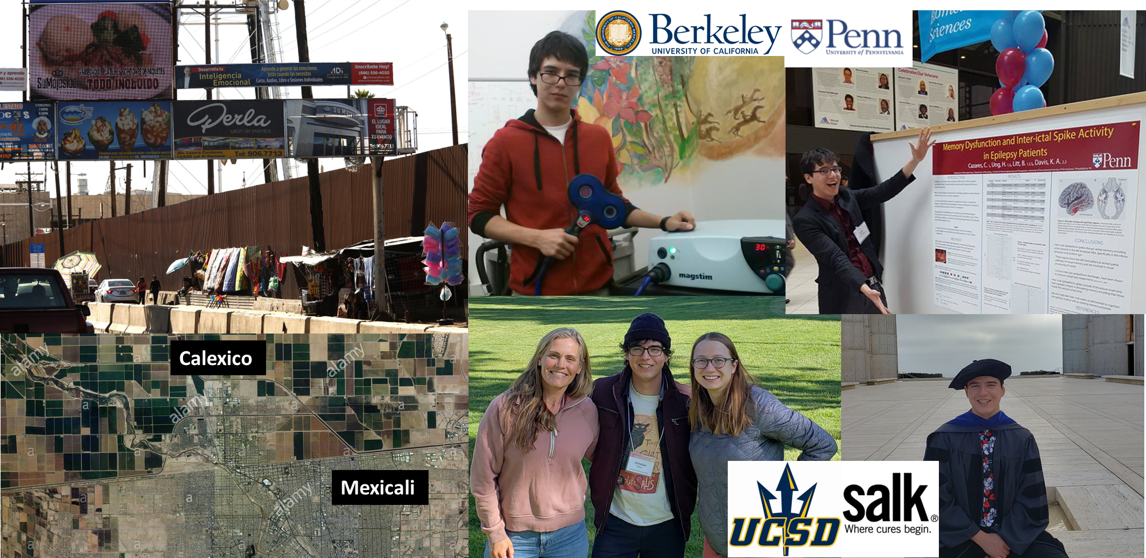
Christian Cazares, Ph.D.
B.A. in Cognitive Science
UC Berkeley
2010-2014
Post-baccalaureate
Researcher
UPenn
2014-2016
Ph.D. in Neuroscience
UC San Diego
2016-2022
Postdoctoral Researcher
Salk Institute / UC San Diego
2022-???
Research Interests:
Biomarkers for Neurodevelopmental Disorders
Career goal:
Academic Research

Slide 4
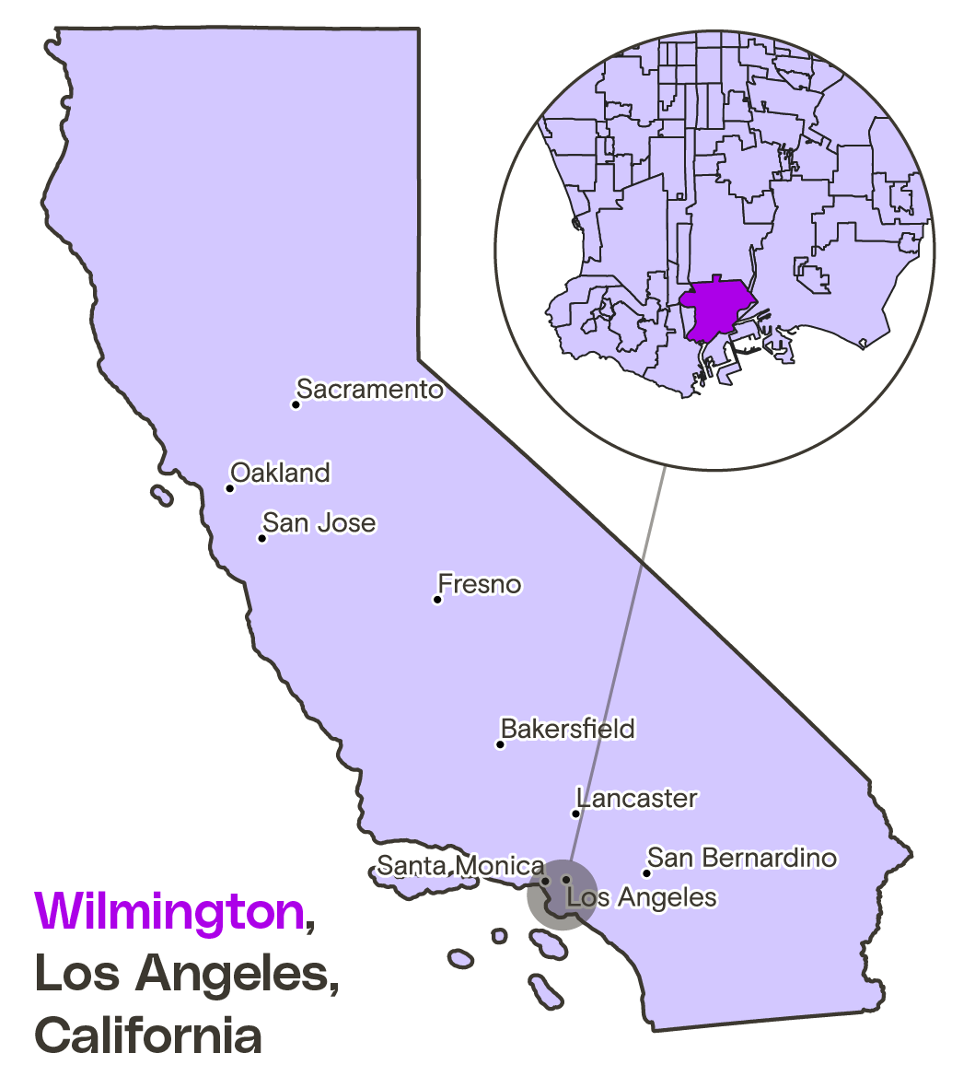
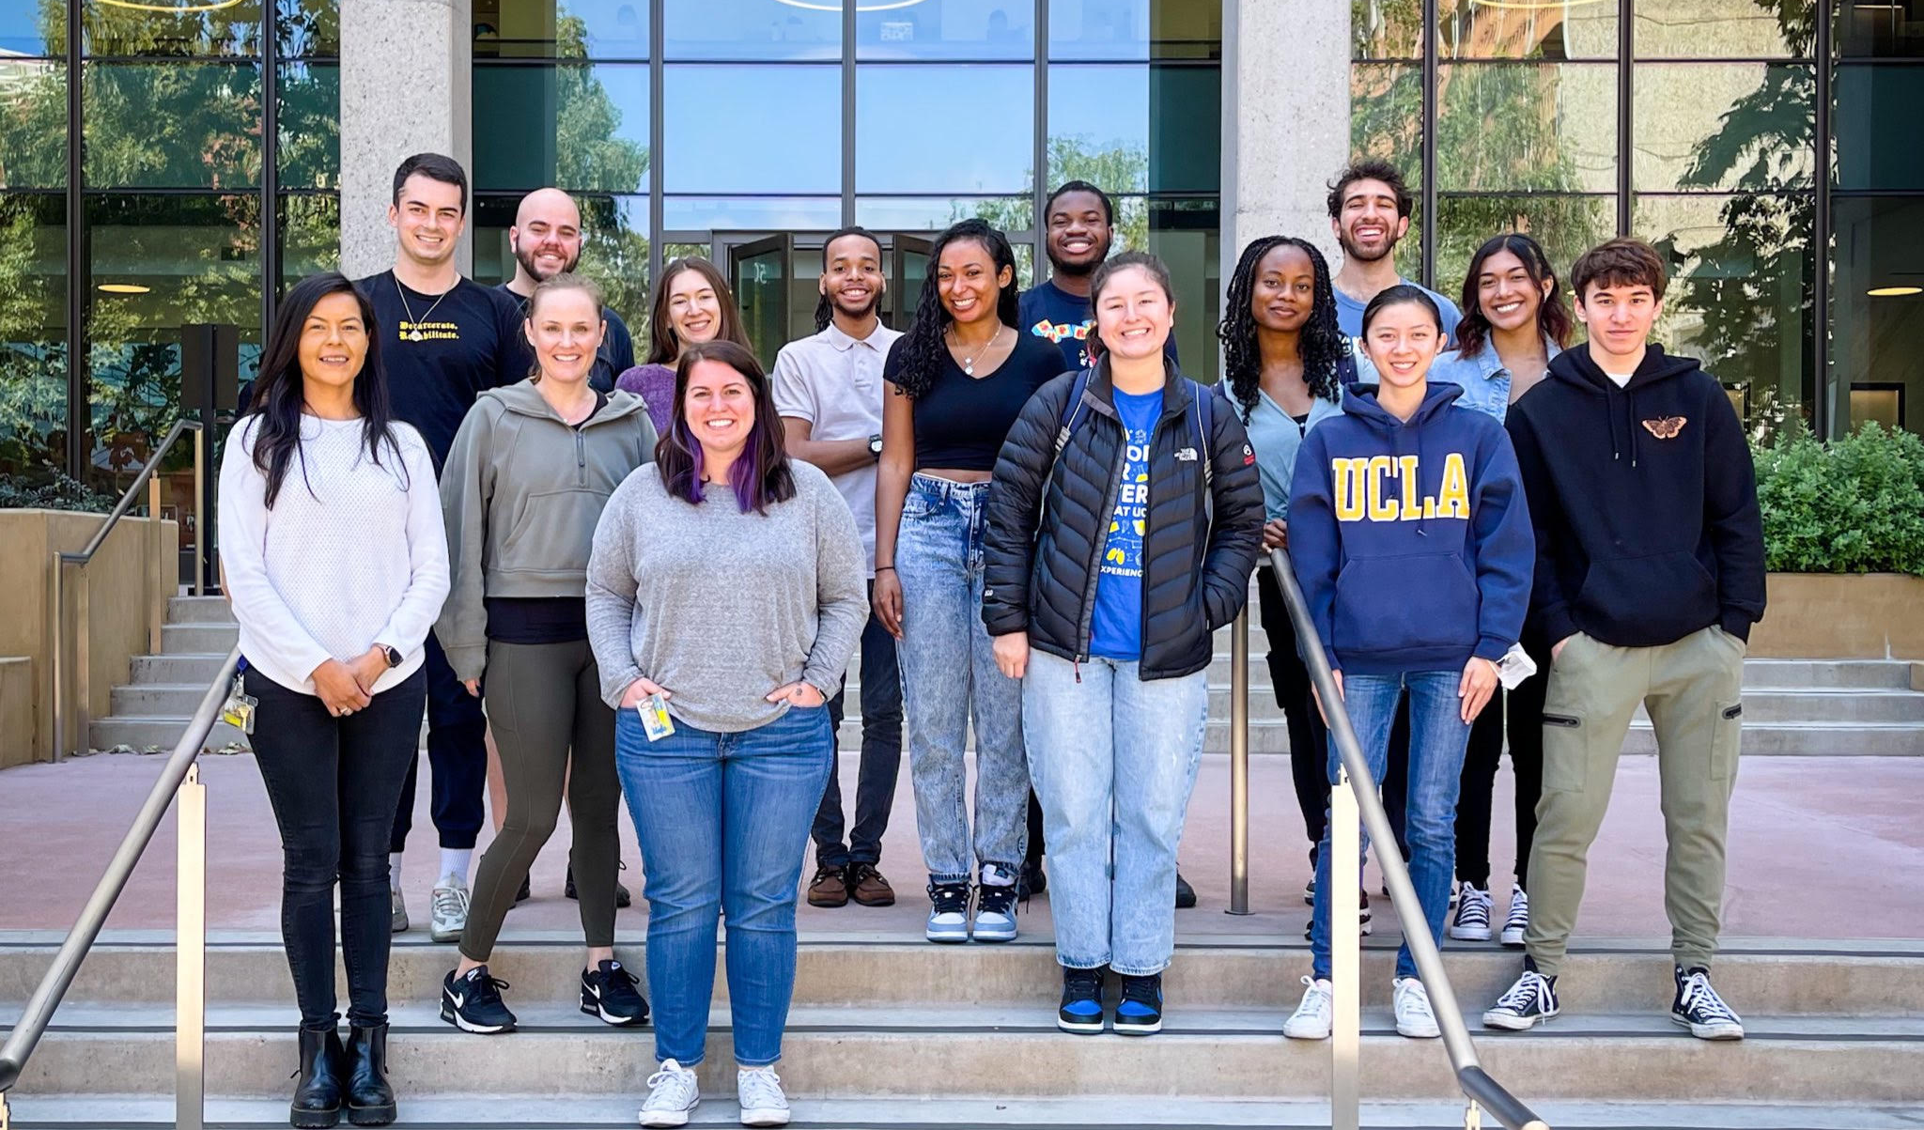
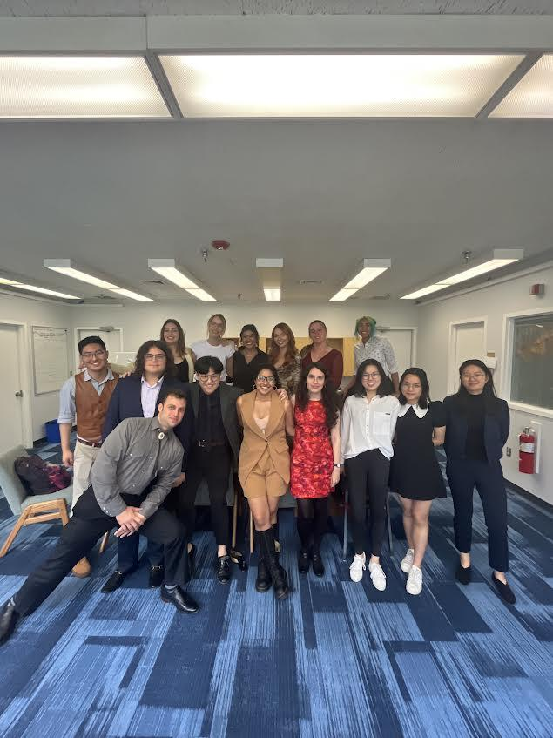


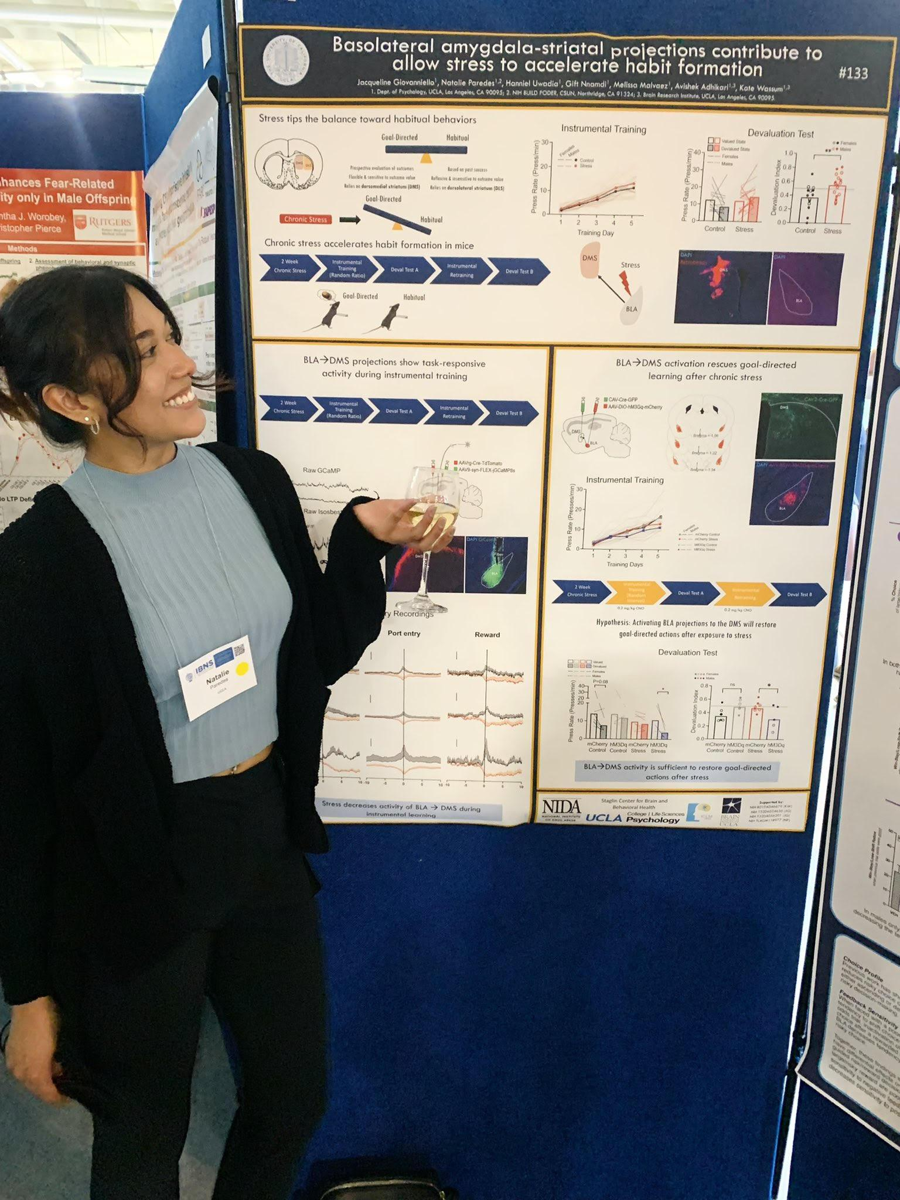
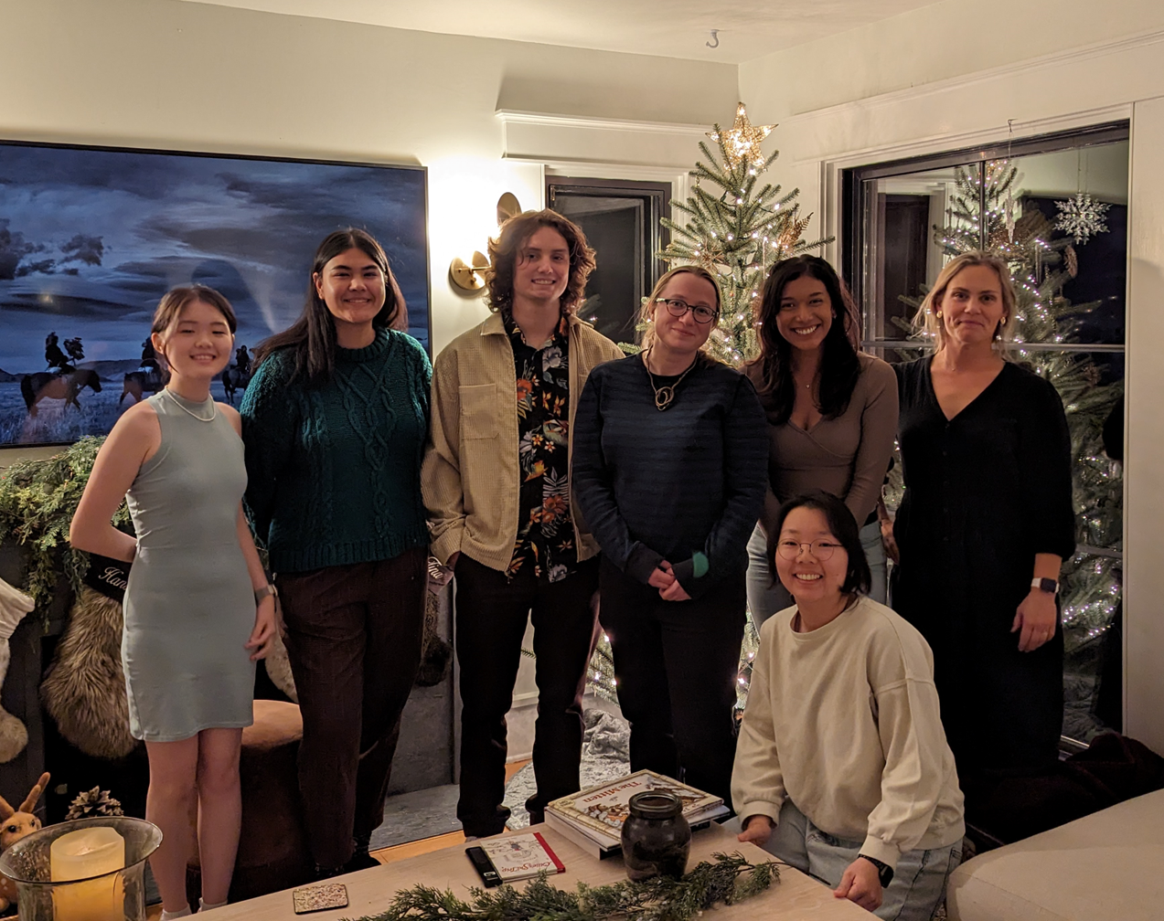
Natalie Paredes
B.A. in Psychology
California State University, Northridge
2017-2021
Post-baccalaureate Researcher
UCLA through CSUN BUILD PODER research program
2021-2022
Ph.D. in Psychology
UC San Diego
2022-???
Research Interests:
Neural mechanisms underlying decision making in disease models
Career goal:
Academic Research

Slide 5
Benefit of a gap year(s)
Experience full time research
Individualized projects, Journal Clubs, Seminars
Is graduate school the right path?
Professional development and increased prospects for graduate programs
History of research productivity is a priority for graduate research programs
Study for GRE/MCAT (some programs offers courses)
Opportunity to present your science through conferences/publications
Secure strong letters of recommendation
Shows evidence for commitment to a career in research

Slide 6
Benefit of a gap year(s)
Experience living in another location
Try out some places you are considering for graduate school
Comprehensive and affordable health insurance (double check this!)
Competitive annual salary
Experience a new type of research environment
Learn about working at the NIH and other US government agencies
Individualized mentorship with faculty and bench mentor
Connections to the scientific community in different disciplines

Slide 7
Post-baccalaureate Research Programs

Slide 8
Post-baccalaureate Research Programs
Support active research participation by recent graduates in STEM disciplines
typically in projects that involve students in meaningful ways in ongoing research programs or in research projects specifically designed for the program.
Graduates intent on remaining within the academic community may find that a post-bac provides the laboratory experience needed before moving on to pursue a master’s degree or doctorate (Ph.D.)
Expectations may include:
Collecting/Analyzing data
Presenting your findings in an internal poster/talk session
Attending mandatory meetings/workshops prepping you for a graduate education
Live in a different city housed with other program cohort members for an academic year
What do you get out of it?
$$$ (PhD post bacs DIFFERENT than med school ones - you get paid!!!)
Exposure to a completely different field
Professional contact and mentorship with principal investigator (PI) of lab (e.g. Letter of Recommendation)
GRE test prep
Graduate application assistance (e.g. Statement of Purpose)
Network of peers
Travel the country! Impress your CV readers!

Slide 9
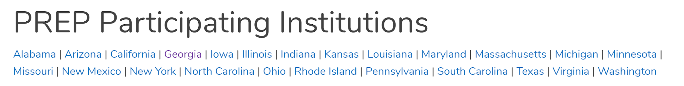
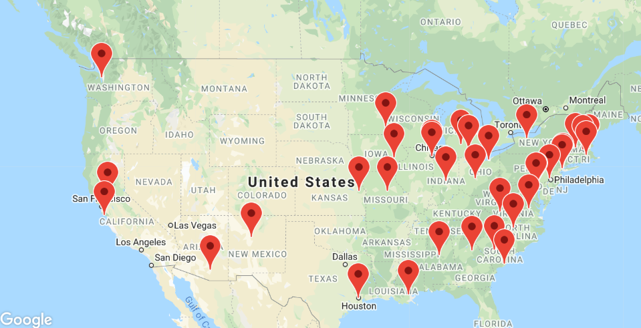
Notes:
https://www.nigms.nih.gov/training/PREP/Pages/default.aspx
The goal of The Postbaccalaureate Research Education Program (PREP) is to develop a diverse pool of well-trained postbaccalaureates who will transition into and complete rigorous biomedical, research-focused doctoral degree programs (e.g., Ph.D. or M.D./Ph.D.) in biomedical fields relevant to the NIGMS mission. The Research Education grant provides support for personnel costs (e.g., salary support of Principal Investigator(s) and a program coordinator), participant costs (i.e., remuneration for PREP scholars through salary and wages, and participant travel), and other program related expenses (e.g., consultant costs, equipment, supplies). Full details are found in the Funding Opportunity Announcement (FOA) PAR-20-066.

Slide 10
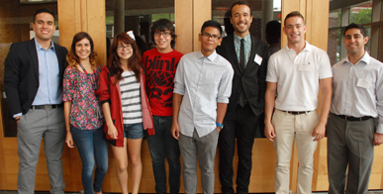
PennPREP
Post-Baccalaureate Research Education Program
https://www.med.upenn.edu/prep/admission.shtml
Research seminars, retreats, and conferences
One academic course per semester
Workshops in scientific writing, public speaking, career advising, and Responsible Conduct of Research (RCR)
Standardized test preparation courses
Application assistance, with a focus on the personal essay and interview skills
Social activities with other PREP scholars, program staff, undergraduate interns, graduate students, and laboratory associates
PREP scholars also receive a competitive stipend, including health insurance

Slide 11
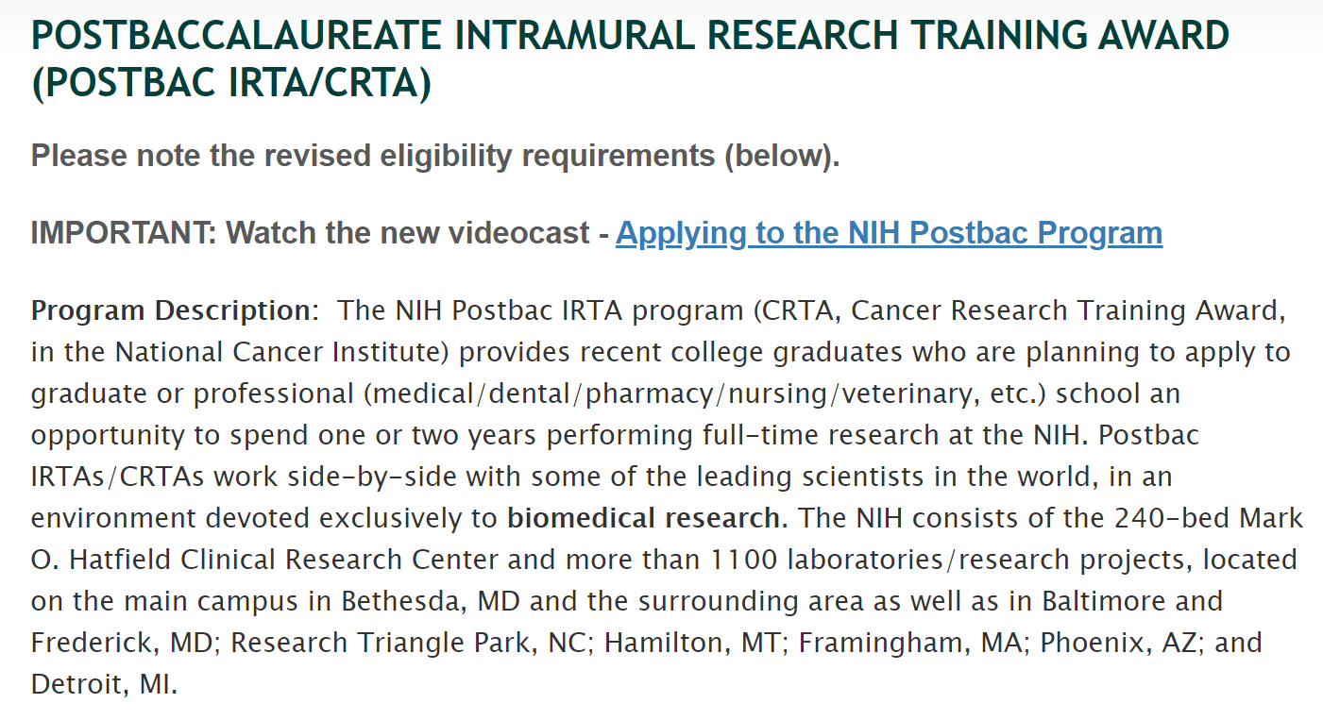
Postbaccalaureate Intramural Research Training Award (Postbac Irta/Crta)
https://www.training.nih.gov/programs/postbac_irta

Slide 12
NIH Intramural Postbac Program
https://www.training.nih.gov/programs/postbac_irta
At the NIH, you can ask for whom you want to work with!
The NIH-wide Office of Intramural Training & Education (OITE) sponsors a wide range of career and professional development activities for postbacs:
Skills workshops on topics such as oral and poster presentations and improving mentoring relationships
Workshops on getting to graduate school and getting to professional school
Career exploration sessions
A Graduate & Professional School Fair
Postbac Poster Day
While not a guarantee, it’s a good idea to contact researchers you’re interested in working with
NIH Researcher Databases
https://intramural.nih.gov/search/index.taf
https://irp.nih.gov/our-research/principal-investigators/focus
Video with program explanation and application components
https://www.training.nih.gov/oite-yt/applyingpostbacprogram

Slide 13
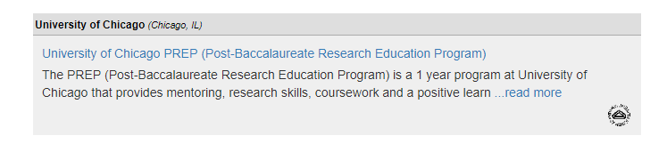
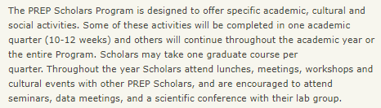
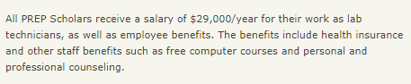
Example using Pathways to Science:
http://bsdprep.uchicago.edu/page/application-procedure

Slide 14
Lab Manager/Assistant Job Positions

Slide 15
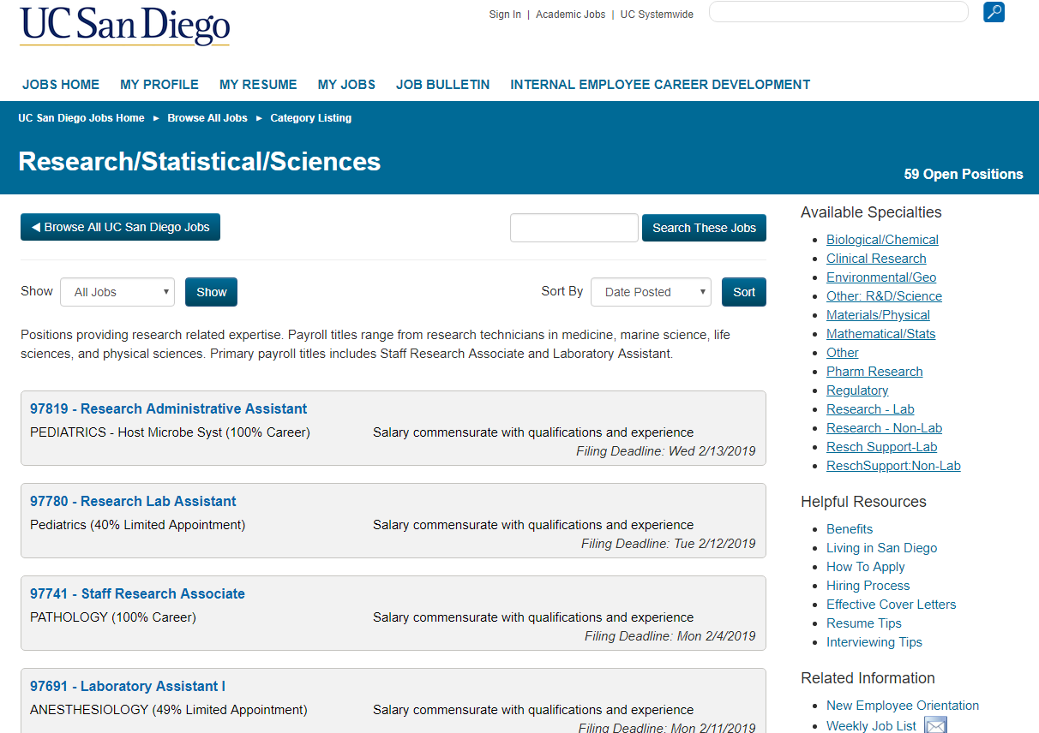
Lab Manager/Assistant Job Positions
https://jobs.ucsd.edu/bulletin/ByCategory.aspx?cat=research
Expectations may include:
Collecting/Analyzing data
laboratory support (ordering, receiving and distributing laboratory supplies),
Coordinating lab meetings/scheduling/travel
Maintaining animal colony
What do you get out of it?
$$$
Exposure to a completely different field
Professional contact and mentorship with principal investigator (PI) of lab (e.g. Letter of Recommendation)
Time to do your graduate applications

Slide 16
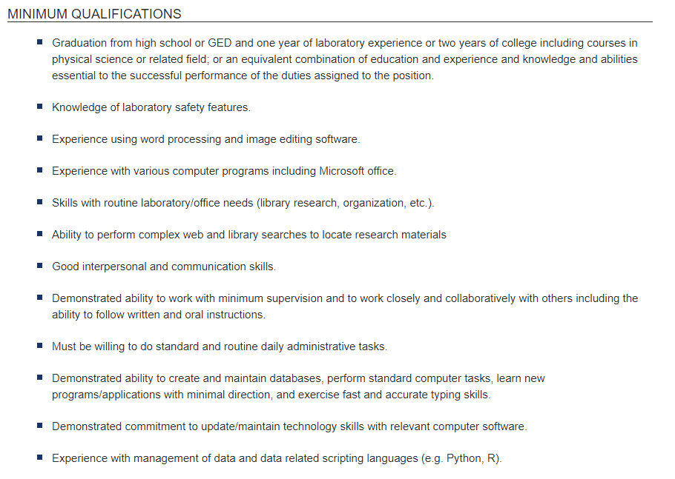
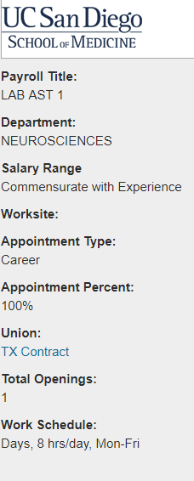
Lab Manager/Assistant Job Positions
https://jobs.ucsd.edu/bulletin/ByCategory.aspx?cat=research

Slide 17
Lab Manager/Assistant Job Positions
Be aware:
These positions can lean towards being “word-of-mouth” about their hiring
It’s difficult to know by when exactly a lab manager position will be advertised (may not follow academic calendar)
The nature of the job may be more restrictive about work hours, however work-life balance is more than possible
Some positions may require you to be comfortable handling animals

Slide 18
Missed the deadlines? Don’t give up, email professors!
Hello Dr. [X],
My name is [X] and I am a [1st,2nd, 3rd year etc.] majoring in [x, or intending to major in X].
[How you found out about the lab, i.e. a class you took with them, or a study you found online, or maybe you checked out their website and something about their research interested you]
Would it be possible to meet and chat about the possibility of working in your lab as a research assistant?
Thank you,
[X]
Email a batch of professors and
give them a couple of weeks to respond
Nothing? Try another batch, or be more direct
by finding out who the graduate students are in their lab website, and email them directly
Notes:
However I've found the most success when keeping things short and to the point. One can go on and on about their interests and qualifications to work in the lab (i.e. I have taken X class), but I think that is getting a little too ahead. The first thing you want to find out is whether they're even taking students or not, the details about what you can do in the lab are always hammered out later.

Slide 19
Master’s Degrees

Slide 20
Master’s Degree
A master degree is good choice when you…
Know that your chosen career will require a master’s degree
Need a graduate degree to qualify for a higher salary grade
Know a career within academia is not your goal
A master’s degree typically requires a year and one-half to two years of full-time study.
Be aware:
For most programs, you have to finance your degree (unlike Ph.D. and postbac positions)
Many jobs do not require a masters
A masters may not necessarily increase your chances at being accepted to a Ph.D. program, it’s the quality of the research experience that counts!

Slide 21
Premedical programs

Slide 22
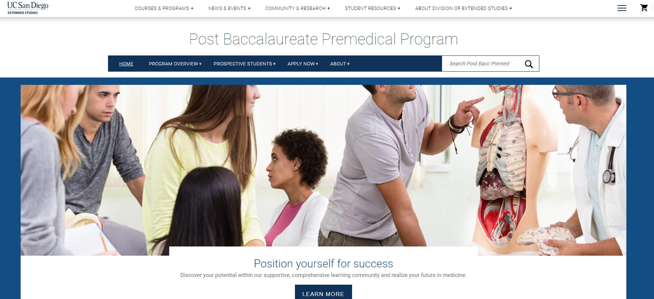
UC San Diego Post Bacc Premed Program
The UC San Diego Post Bacc Premed Program is designed for first-time and re-applicants to medical schools who have already completed their medical prerequisite coursework, but who wish to enhance their academic record within a personalized and supportive, cohort-based learning community.
establishing a strong GPA in upper division Biological Sciences courses,
reaffirming knowledge gained in undergraduate science courses,
preparing for and taking the MCAT, and developing strong medical school applications,
personal statements and interview skills
https://extendedstudies.ucsd.edu/postbacpremed/home

Slide 23
Other options/ resources

Slide 24
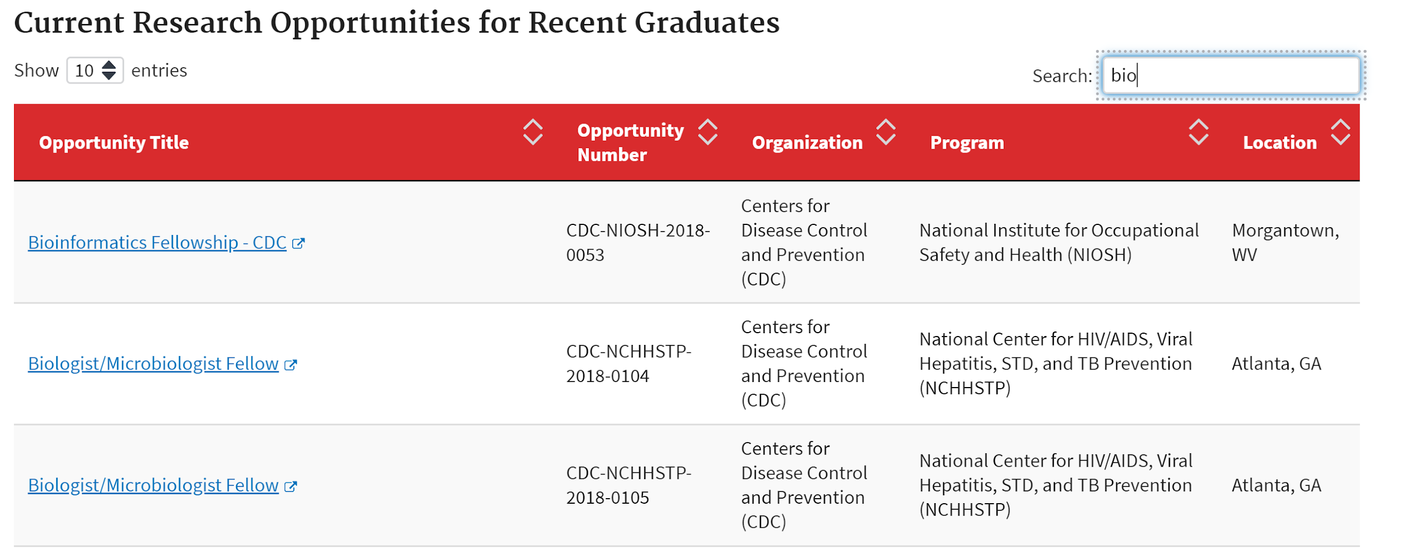
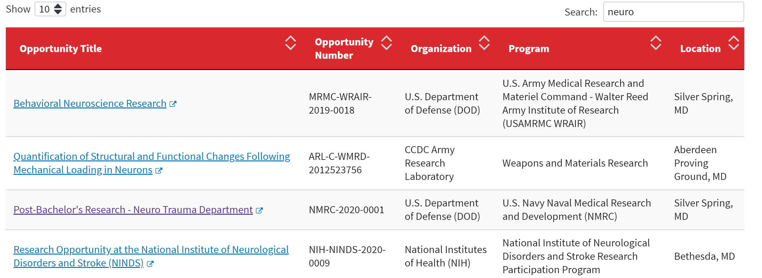
Oak Ridge Institute for Science and Education (ORISE)
ORISE administers a broad range of internships, fellowships, and research experiences available primarily to those pursuing science, technology, engineering, and math (STEM) disciplines, including undergraduate and graduate students, recent graduates, postdocs, and university faculty members. Programs are offered at DOE national laboratories and other federal agencies with research facilities located across the country as well as some locations outside the United States.

Slide 25
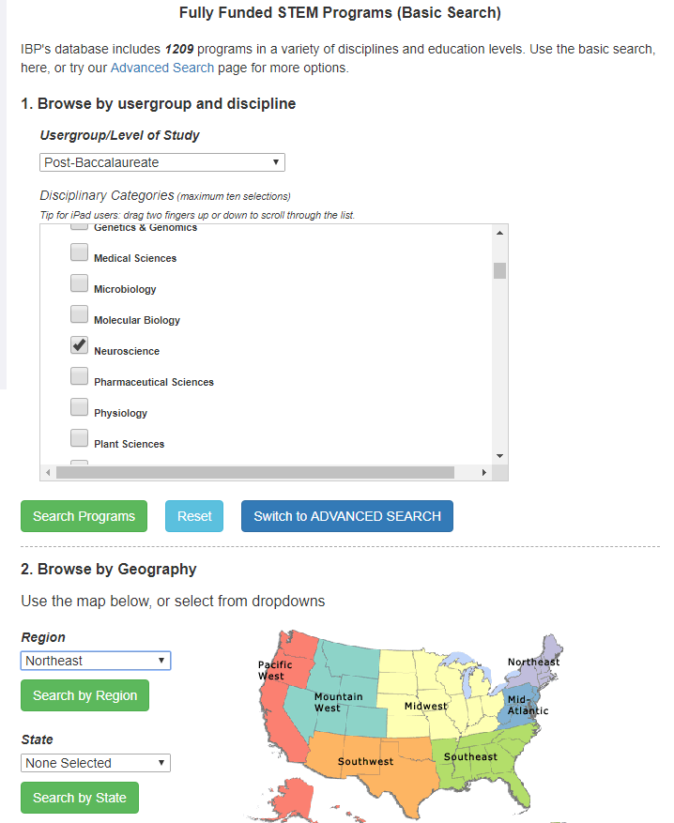
Overwhelmed?
Narrow your search:
Is there a class you took that you want to learn more about the topic?
Is there a university you could see yourself applying to?
Are you looking for a structured program with graduate school prep?
Where do you want to try out living in?
e.g. Have you ever been curious about life in the East Coast?
https://www.pathwaystoscience.org/programs.aspx
Example using Pathways to Science:
“I want to check out what neuroscience research is all about, and I’d like to try life in the Midwest…”

Slide 26
Preparing to apply to a position

Slide 27
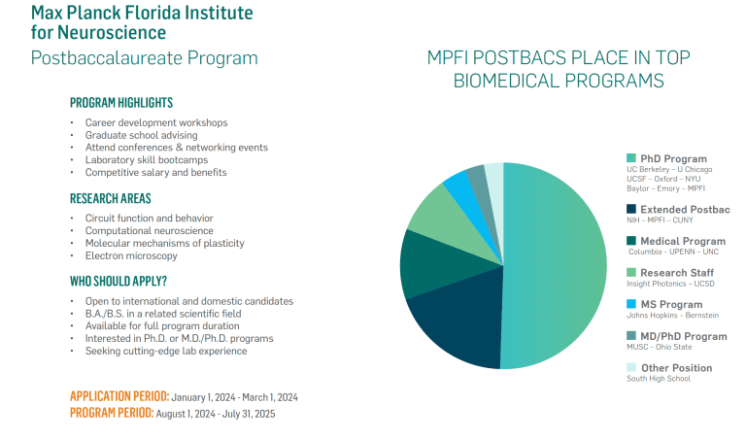
Preparing to apply to a position

Slide 28
Application components
Applicants must provide the following information and documents to successfully submit the application:
Basic contact information (Name, mailing address, phone number, email)
Names and contact information for two referees (faculty level strongly preferred)
CV/resume
Research Statement (1,000 words max) Please provide a research statement describing your qualifications and motivation for applying to the Postbac Program at MPFI. In your research statement, succinctly describe (1) your previous research experience (including experimental approaches and data analysis tools used) and how this experience has prepared you for the Postbac Program at MPFI, (2) your academic and career goals and how the Postbac Program will help you achieve these goals, and (3) which research group you are most interested in working with at MPFI and why.
Unofficial transcripts for every university that you have attended

Slide 29
Application components: Reference Letter
Remember that reference letters will not always be glowing. When in doubt, ask if the referee is willing to write you a strong letter.
Give referees sufficient time, send gentle reminders and, as a back-up, ask one or two others if they are willing to write a letter for you.
Make sure they know the online request is coming and when to expect it.
Communicate clear deadlines to submit reference. Say one at least a day before real date.
Make sure to state why you are looking for a reference letter. Providing the "why" allows the reference to ensure the information they give you is in the right context.

Slide 30
Application components: Statement
Key elements to include in your statement:
Who are you?
What have you accomplished?
Why are you applying?
How will you contribute to the research groups you are interested in? Why these groups?

Slide 31
Statement: Who are you?
Use stories to show your personal connection to science and how your lived experiences can uniquely drive new insights.
What life experiences motivated you to pursue a science career?
What barriers have you faced in pursuit of your career goals?
What drives your science? Is it your will to do good in the world, your curiosity and love of understanding?
Describe how you have gone out of your way to get experience in science.
What steps did you first take to gain career experience?
What led you down this career path?
What are the questions that drive you and your science, and why are they important?

Slide 32
Demonstrate everything by example; don’t say directly that you’re a persistent person, show it.
“I love science. I love to study it, to breath it, to be it. Science is the foundation for all that we are. I have worked long hours pursuing my goal to become a scientist.“
Better:
[After repeatedly talking about interdisciplinary research experiences]
“Overall, my varied research experiences have prepared me for success in science by instilling in me a sense of persistence in learning new material and approaching research problems through the lenses of multiple fields of study.”

Slide 33
Statement: What have you accomplished?
For each significant science-related work experience, answer the following:
Why did you seek this position and how did it relate you your career/science goals?
How did you find this position? A good place to show how you took initiative
What broad topics did the position cover? What problem were you trying to solve and how?
How did you contribute? What progress did you make? Was there an outcome such as a presentation, publication, honors thesis, or award?
How did the experience help you to discover new problems you’d like to examine in the future? How did it inform the next experience you embarked on?
Repeat for each experience!

Slide 34
Example: Discuss the relevance of broader activities
Mention any other significant experiences (outreach, teaching, leadership, community service, etc.) that highlight your potential as a researcher and/or mentor.
“Due to my major’s interdisciplinary course load, I also took the liberty to volunteer as an adviser for psychology undergraduates who were excited when they heard from me how they could combine their research with more computational and biology centered approaches. In addition, a year as an editor for the Undergraduate Journal of Psychology at … gave me valuable academic writing experience. From elementary math, to middle school English, I went from tutor, to teacher, and finally to lecturer when I signed myself up as a volunteer … High School SAT teacher for a program which catered to disadvantaged minority students.”

Slide 35
Statement: Why are you applying?
Address why you need this program or opportunity.
Do you need research experience? Career preparation?
Will it help address weaknesses in your resume/CV?
Looking to explore a different subdiscipline?
Need science mentorship that will be able to serve as informed references
Explain how this opportunity will uniquely address these needs:
You will build familiarity with full-time research
You will build familiarity with the science career environment
Exclusive networking and professional development (be specific!)
Accelerated coursework (some programs allow you to take graduate courses)
MCAT or GRE preparation

Slide 36
Statement: How will you contribute?
Based on the experiences, you should demonstrate a certain level of familiarity with the discipline. Explain how your contributions and ideas formed from prior experiences relate to important questions in the field, using the language of the discipline.
Share how you want to approach the field! How will you innovate? Your path is unique!
For example, you might situate yourself as more experimental or computational. You can argue that your experience with some specific topic gives you a foothold to continue working on that topic—or you can indicate your intention to broaden or shift your focus to answer new questions.
To demonstrate fit for the program, it’s a good idea to name 2 or 3 faculty members or labs as potential advisors. Explain which aspects of their research appeal to you.
Do your homework and browse websites of interesting faculty (or group) in each program you apply to.

Slide 37
Example: Elaborate on your “fit” for the graduate program, and any perceived “weaknesses” in your application
“My interests in researching drug addiction align perfectly with the opportunities offered by the …. Program. Quarterly rotations with faculty such as Dr. … and Dr. … would provide me with the opportunity to research how neuronal networks influence the transition from initial drug use to dependence. Furthermore, [The programs]’s two-week Boot Camp for first years sends a signal to me that [program] cares about making the hard transition into [science careers] manageable for their students.”

Slide 38
Application components: Common Pitfalls
Stating your interest in a field, but not the specifics of why
“My experiences with family members suffering from Alzheimer’s inspired me to study neurodegenerative disorders”
Why? Was it the cognitive decline impacting your relationship with family members? Why did it inspire you? Did you set off to find the cause why this occurs? Did you begin to be curious about the development of a cure? How does your personal experience with the disease apply to society at large?
Forgetting to say anything about why the specific program you’re applying to is the one that will aid your transition to your next career step
Talking about research experiences as a summary of the research, rather than about your contributions and how those contributions influenced your research interests and decision to pursue a career in research
Forgetting to mention significant accomplishments (e.g. poster presentation, award, publication, etc.) This really isn’t the time to be humble, you’re trying to be a competitive applicant!

Slide 39

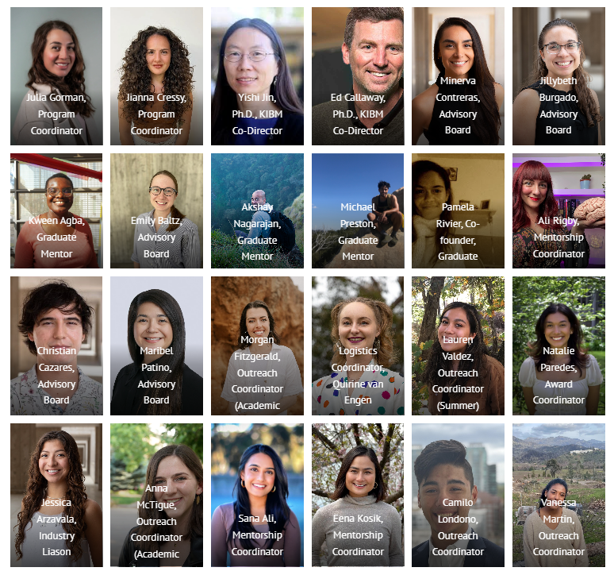
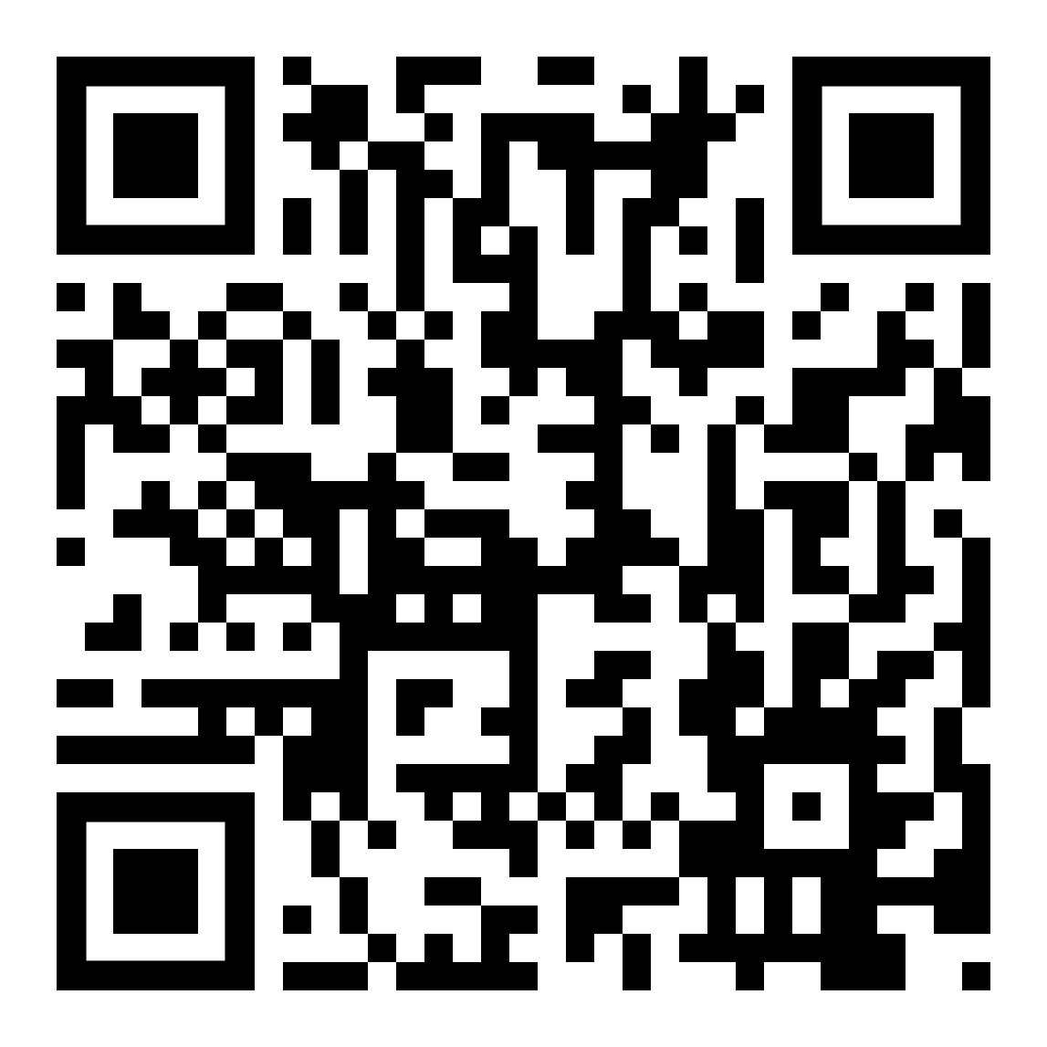
colorsofthebrain.com
Twitter: @UCSD_CoB
Youtube: @cobucsd992
QR code for materials used in our workshops

